Slide 1



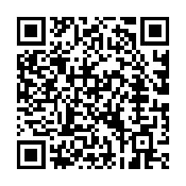



Basket Behaviour Analysis
12/10/2025
Presented by:
  Olabode Ajayi
  Norhelia Echevarria
  Tanya Kavuru
  Shanif Lakhani
Reference: https://www.instacart.com

Slide 2






PROBLEM STATEMENT
Instacart faces the challenge of identifying the key drivers of customer loyalty and repeat purchasing amid rapidly growing user activity and complex, dispersed transactional data.
Emma, Product & Ops Lead
Mateo, Data Scientist
Priya, Marketing Analyst
Which customers and products drive repeat business, when do customers order, and which product bundles can increase basket size via cross-sell?
Which signals (user-level, product-level, sequence embeddings, time features) best predict reorder behavior and days-to-next-order?
Which segments (light/medium/heavy) respond best to cross-sell, and which product pairs yield highest lift?

Slide 3
EXECUTIVE SUMMARY
Instacart is a grocery delivery platform whose customers exhibit clear temporal shopping patterns and concentrated repeat-purchase behavior. A small set of products and departments account for most reorders, with high-frequency users driving a disproportionate share of the volume. Several product pairs also demonstrate strong co-purchase relationships, indicating cross-sell potential.
Key Finding
Reorder hotspots
Light/Medium/Heavy segments differ in reorder probability and responsiveness to offers.
Recommended Actions
Reorder hotspots
Light/Medium/Heavy segments differ in reorder probability and responsiveness to offers.
Success Metrics
Descriptive, Predictive,
Operational (reduced under/over‑staffing hours)
Instacart’s mission is to create a world where everyone has access to the food they love and more time to enjoy it together.

Slide 4
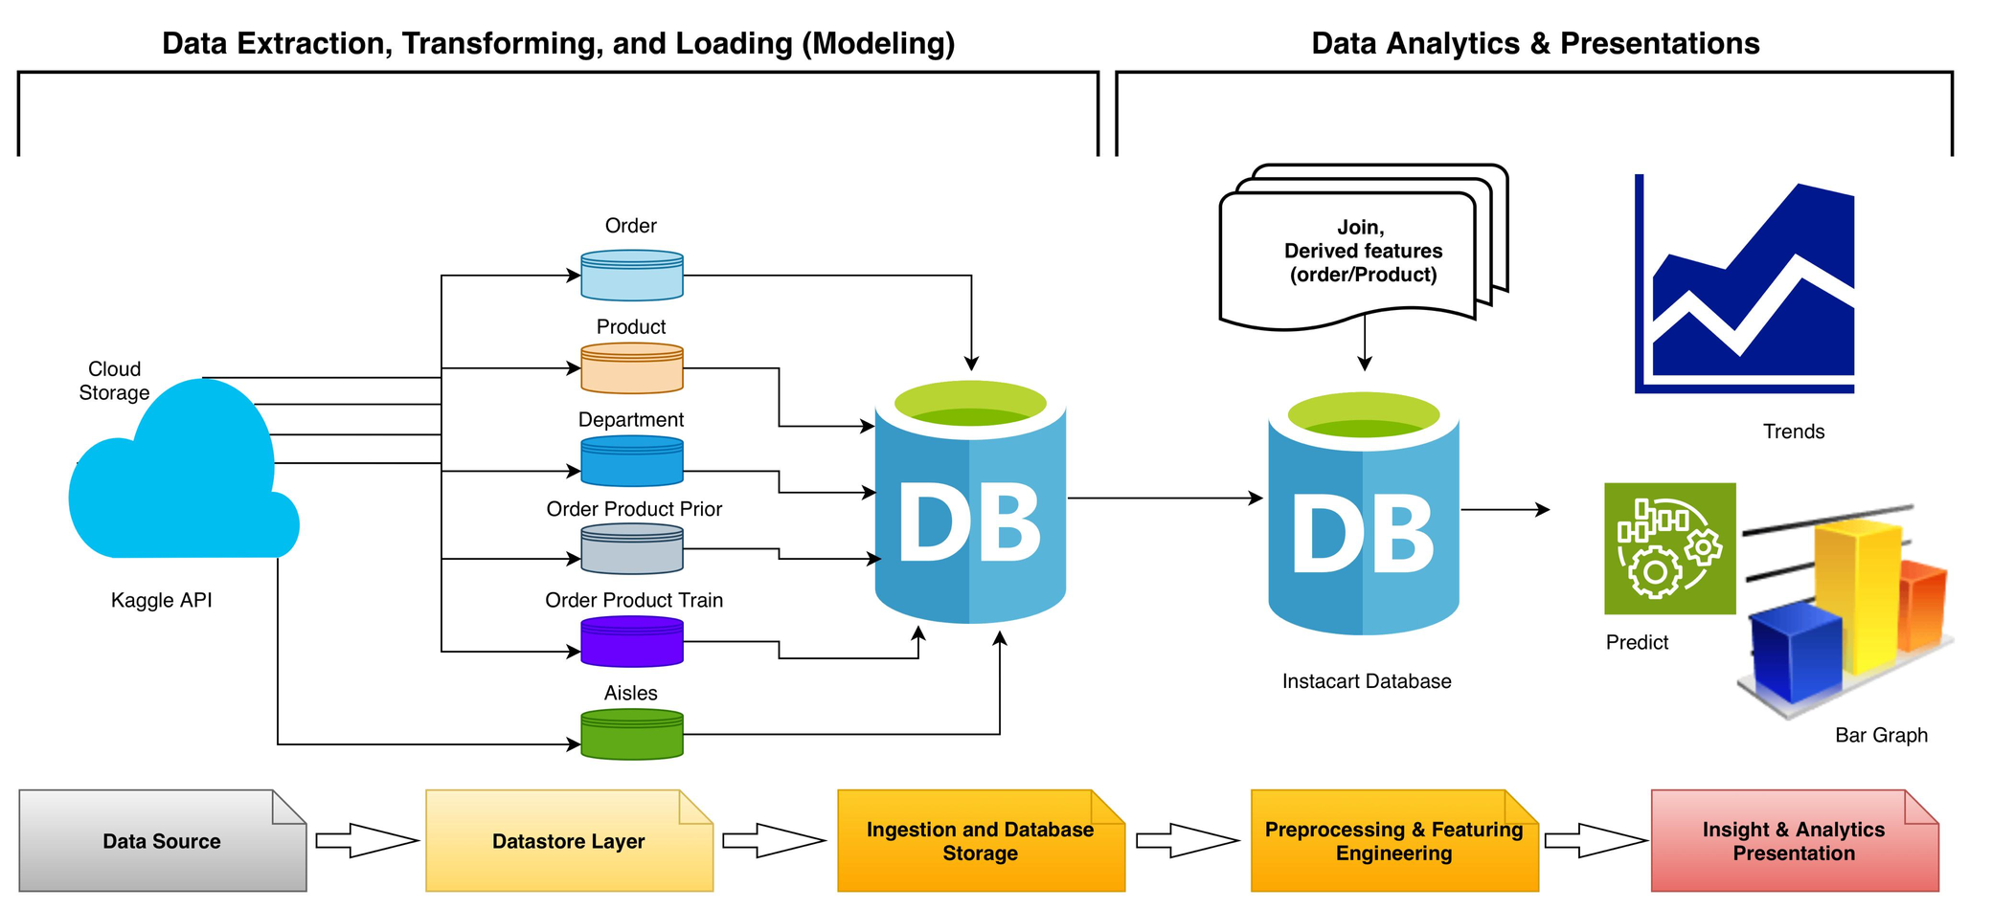
METHODOLOGY APPROACH

Slide 5
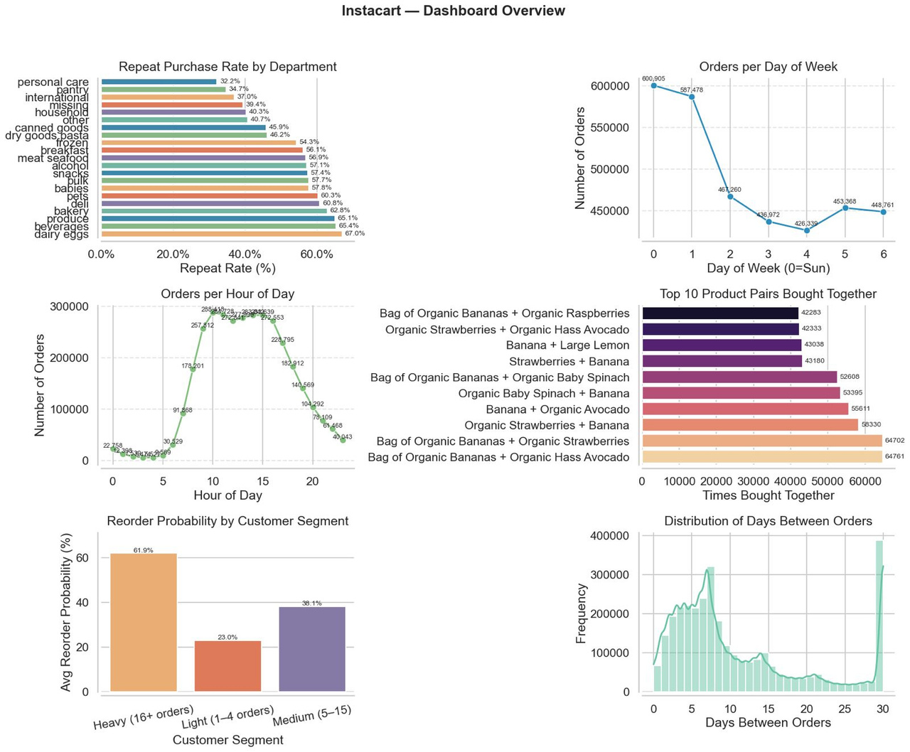
EXPLORE, BUSINESS QUESTIONS & INSIGHTs

Slide 6
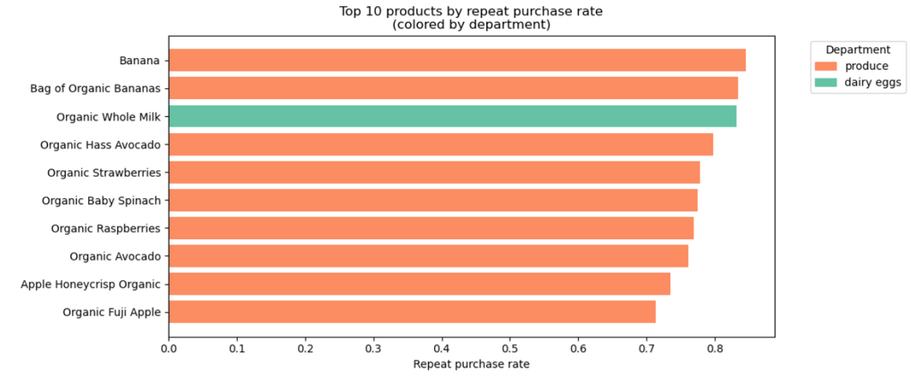
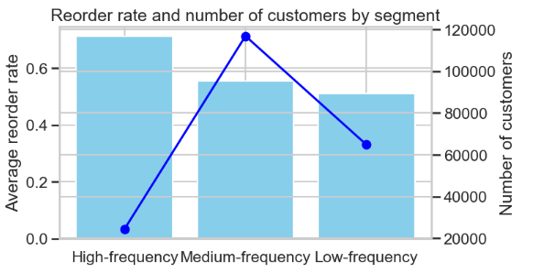
Q: Repeat Purchase Rate (Reorder Rate)
Q: Customer Segments
Insight
  High-frequency users reorder the most, but medium-frequency users are the largest group.
  Low-frequency users show the weakest retention.
Explains
  High-frequency customers are highly loyal; medium-frequency users have strong potential; low-frequency customers engage only occasionally.
Actions
  Boost loyalty for high-frequency users (early access, recurring-order perks).
  Encourage medium-frequency users with reminders and targeted offers.
  Reactivate low-frequency users with first-reorder incentives and reduced friction.
Insight:
  The most frequently reordered products are fresh essentials (bananas, milk, avocados).
Explains:
  Users return to Instacart to restock these staples on a weekly basis.
Action:
  Keeping these items in stock and offering personalized suggestions can strengthen customer loyalty.

Slide 7
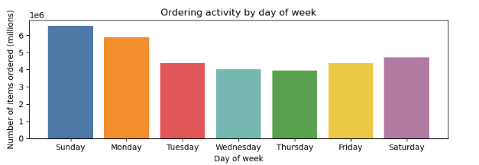
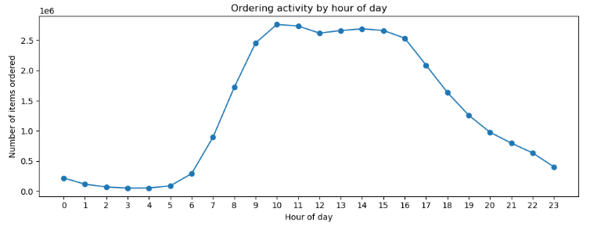
Q: Ordering Behavior
(Day of Week and Hour of Day)
Insight
  Ordering activity peaks on Sundays, Saturdays, and Mondays, and drops to its lowest level mid-week. By hour, demand is highest between 10:00 AM and 3:00 PM, with very low activity from 12:00 AM to 5:00 AM.
Explanation
  Customers rely heavily on Instacart for weekend shopping and weekly restocks.
  Peak midday hours reflect when most users are actively planning meals or preparing for the week.
Actions
  Scale operational capacity (customer support, real-time monitoring, delivery coordination) during weekend and midday peaks.
  Schedule app maintenance and shopper training during low-demand periods.
  Use peak-time insights to optimize staffing and ensure fast, reliable service during high-volume periods.

Slide 8
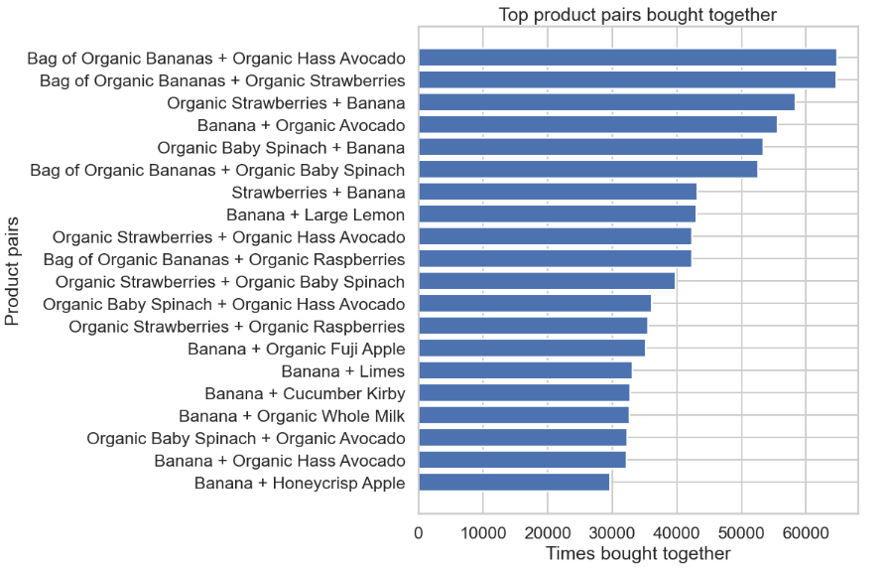
Q: Co-Purchase Analysis (Top Product Pairs)
Insight
  The highest reorder rates come from fresh essentials (bananas, milk, avocados, berries, spinach).
  These items act as anchor products-
Explains
  Customers consistently rely on Instacart to replenish these staples.
  These products drive repeat traffic to the platform and represent predictable, recurring demand.
Actions
  Ensure consistent stock availability for top staples to avoid missed sales and customer frustration.
  Promote personalized recommendations (e.g., “Buy again” or “Complete your basket”).
  Bundle fresh essentials with complementary items (e.g., bananas + yogurt; avocados + tortillas) to increase average order value.

Slide 9
CONCLUSION & RECOMMENDATION
CONCLUSION
  Users place most orders on weekends and during late-morning/early-afternoon hours, revealing predictable demand peaks.
  Fresh essentials (bananas, milk, avocados) drive the highest reorder rates, confirming they are core items in customers’ weekly shopping.
  Most frequently purchased pairs are fruits and vegetables, showing consistent patterns in healthy and routine-oriented purchasing.
  High-frequency users show strong loyalty, while medium-frequency users form the largest and most scalable segment.
RECOMMENDATION
  Ensure maximum platform capacity and shopper availability during peak hours (10 AM–3 PM) and weekends.
  Guarantee constant stock for essential staples to maintain customer satisfaction and prevent order cancellations.
  Introduce automated complementary-product suggestions based on the most common product pairs.
  Segment Strategy:
    High-frequency: loyalty programs and exclusive perks.
    Medium-frequency: personalized promotions to increase reorder likelihood.
    Low-frequency: reactivation offers and reminders to bring them back.

Slide 10

Thank you for your time!
Any Questions
https://www.kaggle.com/datasets/yasserh/instacart-online-grocery-basket-analysis-dataset

